Slide 1


LandSense
Rapid-Response Geo-Intelligence for Landslide Early Warning
Sentinel-LEWS is a critical initiative focused on delivering hyper-local landslide risk prediction with unparalleled precision. Our system provides a 6-hour early warning at a 100 m² resolution, operating fully edge-native and offline to ensure reliability when it matters most.
Our primary target user is the District Disaster Management Officer, who requires immediate, actionable intelligence to protect communities.
Team Name: Team_Genz
Hackathon: Hack The Winter
Theme: Disaster Resilience / Governance
Domain: Machine Learning + IoT + Early Warning Systems

Slide 2
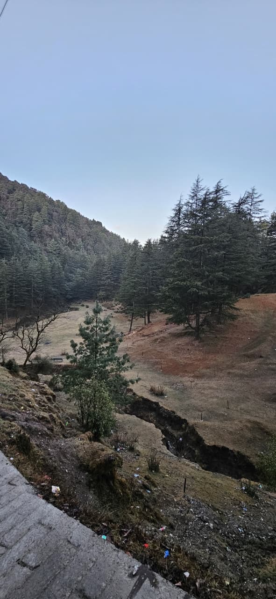

Why Landslides Are Still Deadly
India’s hilly regions face devastating and sudden landslides, often leading to significant loss of life and property. Existing early warning systems fall short:
  They operate at a district level, offering predictions that are too coarse for effective localized response.
  Many are cloud-dependent, rendering them useless during critical monsoon-induced network outages.
The key failure is a lack of systems that work locally, offline, and at a hyper-local scale, leaving vulnerable communities exposed.

Slide 3
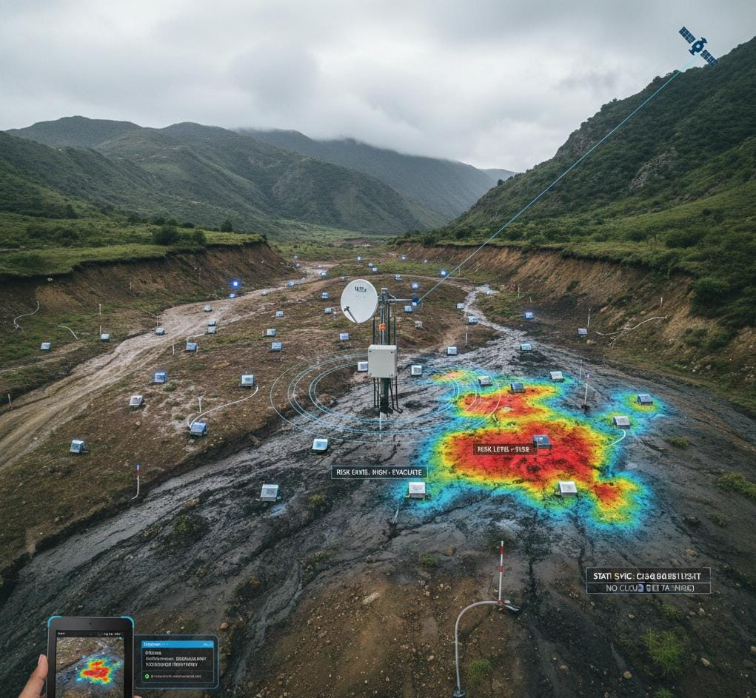
User Story & Hard Constraints
As a District Officer, I want to predict landslide risks at a 100m² resolution using fused sensor data to issue hyper-local evacuation alerts 6 hours before an event.
Hard Constraints for LandSense :
  Response Time: Less than 15 seconds for a 500 km² area.
  Model Size: Model must be under 50 MB for edge hardware deployment.
  Data Synchronization: Requires 256 kbps VSAT sync capability.
  Operational Independence: Absolutely no cloud dependency for core functions.

Slide 4
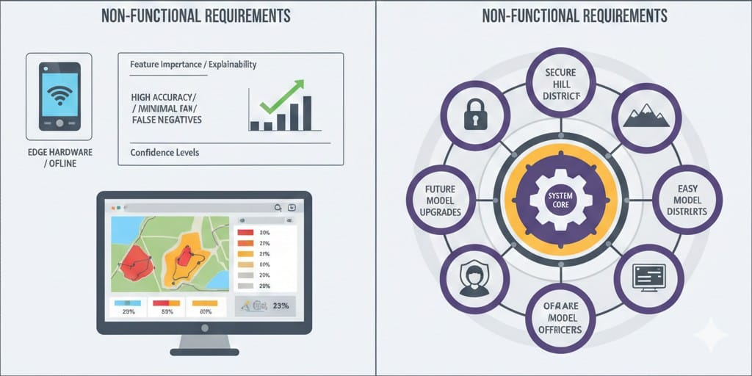
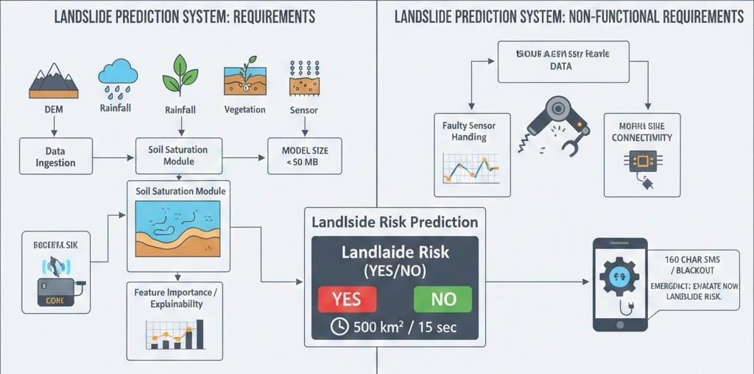
System Requirements
Functional Requirements
Ingest DEM, rainfall, vegetation, soil and sensor data
Derive soil saturation from rainfall and terrain
Generate landslide risk prediction (Yes / No)
Process 500 km² area within 15 seconds
Handle faulty sensor readings automatically
Provide feature importance for explainability
Operate fully offline on edge hardware
Generate hyper-local evacuation alerts
Send 160-character SMS alerts during blackout
Display risk zones and confidence levels on local dashboard
Non-Functional Requirements
Prediction model size must be under 50 MB
System must work without internet connectivity
High reliability during sensor failures
Scalable across multiple hill districts
Easy to use for district officers
High prediction accuracy with minimal false negatives
Secure access to prediction data
Support future model upgrades

Slide 5
Real-World Challenges
1
2
3
Data Heterogeneity
Offline Resilience
Sensor Failure
We grapple with diverse data sources: rainfall data at 25 km grids, terrain data from 30 m Digital Elevation Models (DEMs), and sensor data that is often noisy and sparse.
Internet infrastructure is often the first casualty during natural disasters, making offline functionality a paramount requirement for any effective early warning system.
Approximately 40% of deployed sensors can fail during heavy storms, posing a significant challenge to data integrity and system reliability.

Slide 6
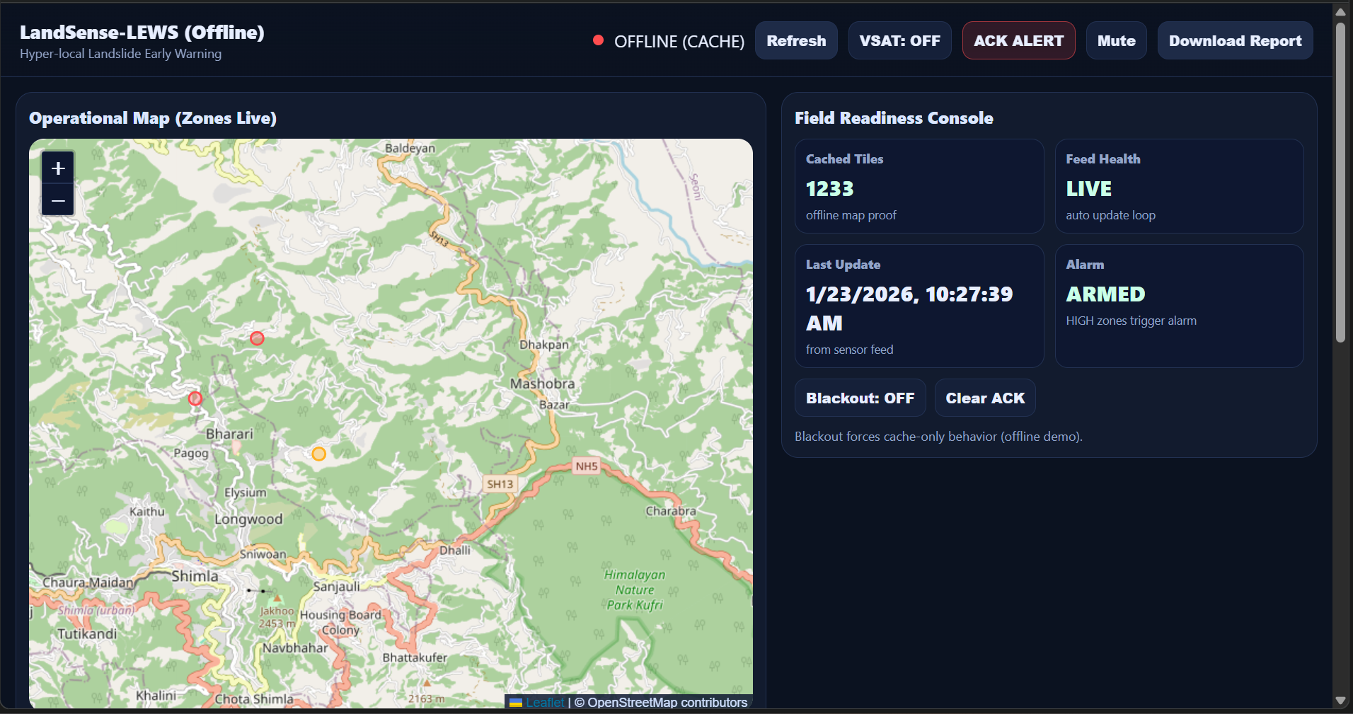
Our Solution: LandSense
LandSense is a groundbreaking terrain-anchored, edge-native ML system designed to overcome current limitations. It:
  Utilizes terrain as the fundamental spatial backbone for all predictions.
  Intelligently converts low-resolution rainfall data into precise soil saturation estimates.
  Operates entirely on local district hardware, ensuring continuous functionality.
Key Insight: Terrain defines resolution — sensors refine confidence.

Slide 7
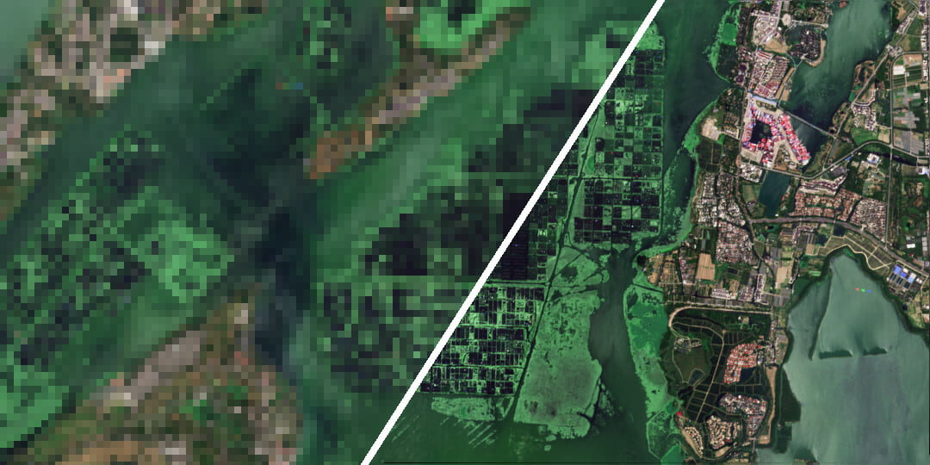
Achieving Hyper-Local Resolution
Our system achieves unprecedented hyper-local resolution by leveraging:
  Base Layer: A high-resolution 30 m Digital Elevation Model (DEM).
  Terrain Cells: Each DEM pixel is treated as a fundamental terrain cell.
  Operational Zones: These cells are then aggregated into precise 100 m² operational zones for risk assessment.

Slide 8
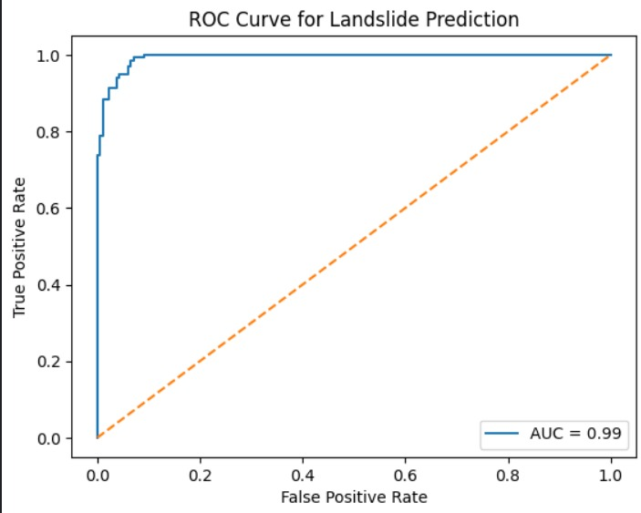
Data & Feature Engineering
Input Data
  Digital Elevation Model (DEM): Slope angles and drainage patterns.
  Historical Rainfall: Detailed CSV records for context.
  Proximity to Water Bodies: Identifying potential saturation zones.
  Vibration / Earthquake Signals: Real-time seismic data.
  Vegetation Cover: Assessing density and type.
  Soil Characteristics: Analyzing composition and permeability.
1
Soil Saturation (Derived)
4
Proximity to Water
Rainfall (Trigger)
5
Vegetation Cover
2
3
Slope Angle
5

Slide 9
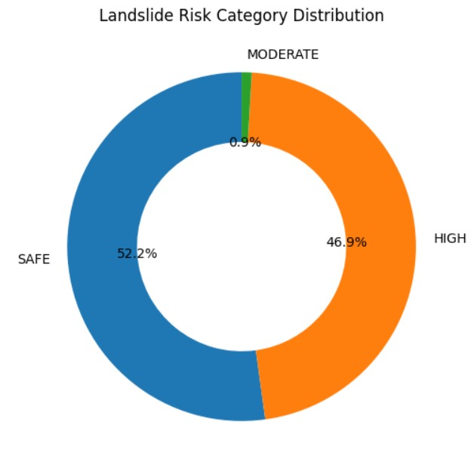
ML Model & Explainability
Machine Learning Model
We utilize a Random Forest Classifier with 300 trees and an average depth of approximately 9. This model provides a binary output: predicting 'Yes' or 'No' for landslide risk.
Why Random Forest?
  Exceptional handling of non-linear geophysical data patterns.
  Robustness against data noise and missing sensor inputs.
  High explainability through feature importance, crucial for trust.
Model Insight : Rainfall is a trigger — soil saturation decides
failure.
Top Predictors
  Soil Saturation
  Earthquake / Vibration
  Rainfall
  Proximity to Water

Slide 10
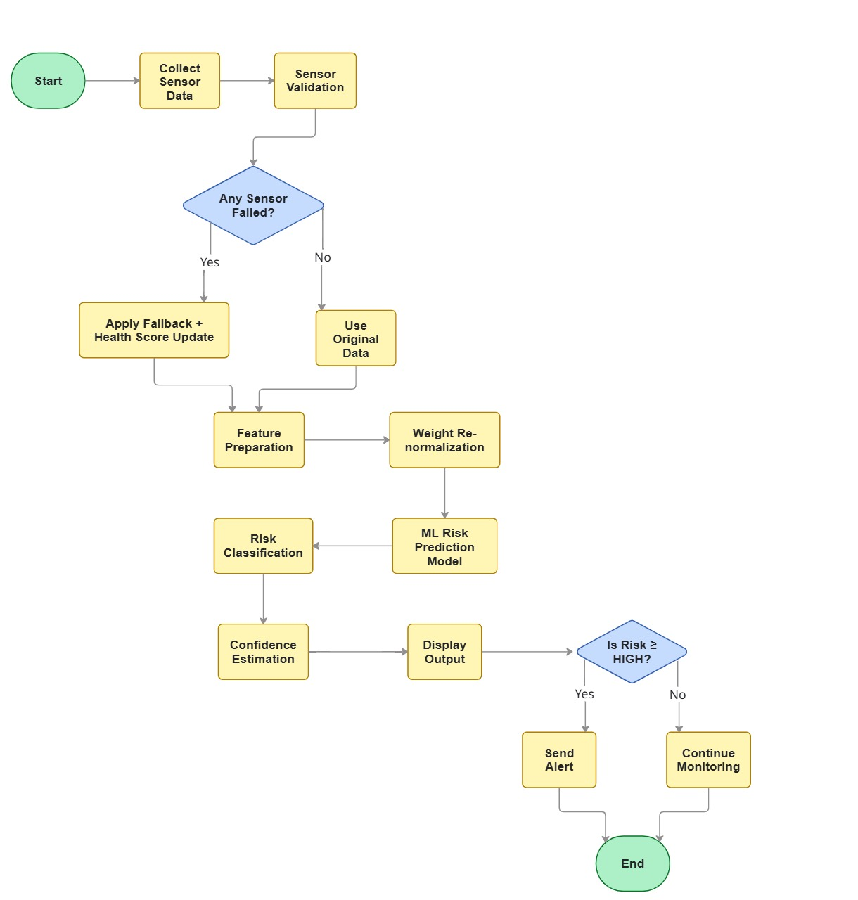
Flowchart
Step-wise Explanation :
Collect Sensor Data
Rainfall, vibration, proximity to water, and terrain features are collected.
Sensor Validation
Sensor readings are checked for noise, drift, or failure.
Sensor Failure Handling
  If a sensor fails → fallback values are applied and health score is updated.
  If healthy → original data is used.
Feature Preparation
Raw data is converted into meaningful risk features.
Weight Re-normalization
Failed sensors are down-weighted instead of stopping the prediction.
ML Risk Prediction Model
The model predicts landslide risk using prepared features.
Risk Classification
Risk is classified as Low / Moderate / High.
Confidence Estimation
Confidence is calculated based on sensor availability.
Decision Output
Risk, confidence, and explanation are displayed.
Alert Logic
If Risk ≥ HIGH → Send Alert
Else → Continue Monitoring

Slide 11
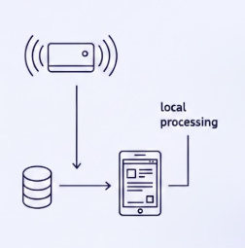
Offline & Failure-Resilient Design
Offline-First Architecture
  The ML model operates entirely on a dedicated edge device.
  No live cloud calls are needed, ensuring operation during outages.
  Dashboard functionalities and alert systems function locally.
Sensor Failure Handling
  Intelligent algorithms detect and address faulty sensors.
  Drift readings are automatically discarded to maintain accuracy.
  System reduces confidence in predictions, rather than ceasing them.

Slide 12
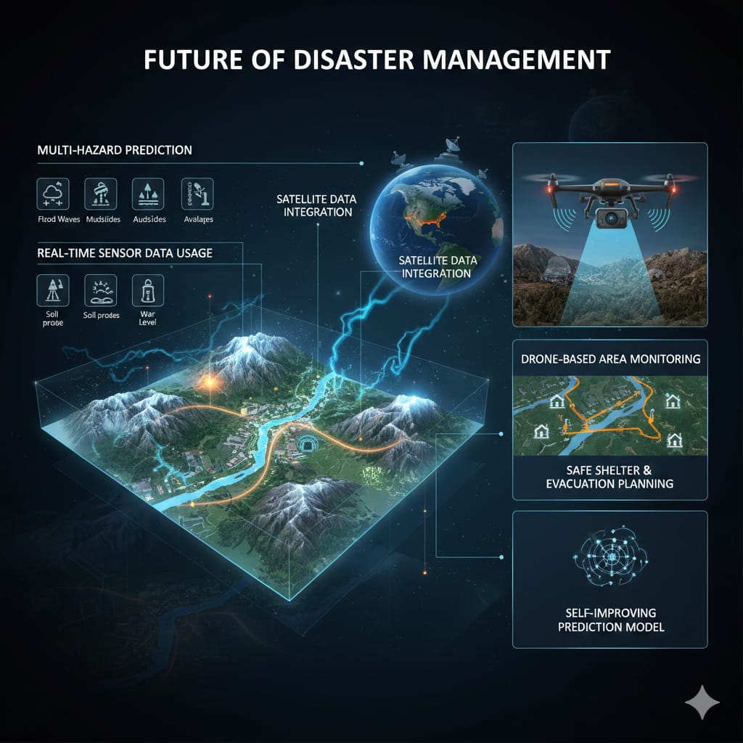
Future Scope of Sentinel-LEWS
1. Multi-Hazard Prediction
• In the future, the system can be expanded to predict floods, debris flows, and avalanches along with landslides using the same terrain data.
2. Real-Time Sensor Data Usage
• Live data from sensors such as rainfall, soil moisture, and water level sensors can be used to make predictions more accurate.
3. Drone-Based Area Monitoring
• Drones can be used to check high-risk areas visually and assess ground conditions after an alert is generated.
4. Safe Shelter and Evacuation Planning
• The system can automatically suggest safe shelters and the best evacuation routes during emergencies.
5. Self-Improving Prediction Model
• The model can learn from new disaster events and update itself to give better predictions in the future.
6. Satellite Data Integration
• Satellite data like rainfall and soil moisture can be used in areas where physical sensors are not available.
7. Large-Scale Deployment
• The system can be scaled and used across multiple districts and states for better disaster management.

Slide 13
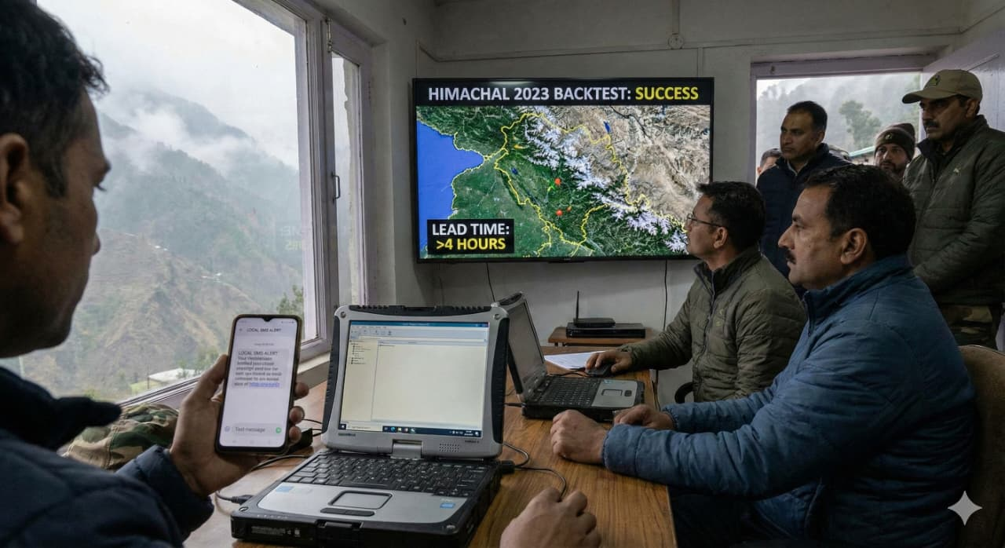
Validation, Impact & Conclusion
Definition of Done
  Successfully backtested on historical events, including
  Himachal 2023.
  Achieved greater than 4 hours lead time for warnings.
  Initiated local-only 160-character SMS alerts during blackout
  conditions.
Impact
  Enables faster, more informed evacuation decisions.
  Delivers hyper-local alerts directly to at-risk communities.
  Guarantees operation even during critical internet outages.
  Designed for scalability across all hill districts.
LandSense empowers District Disaster Management Officers with the vital tool needed to safeguard lives and livelihoods.

